Slide 1
Electrical HW
John Eley – Rust Embedded Spring 2025

Slide 2
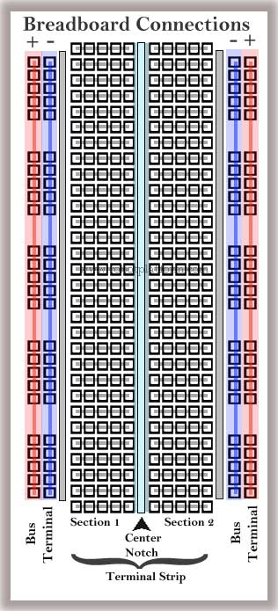
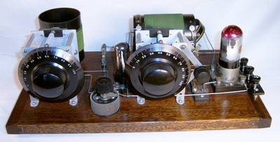
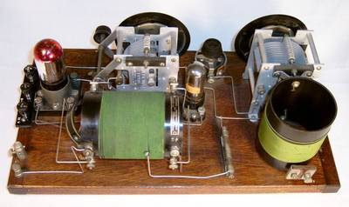
Breadboards
Originally named for the early use of actual wood cutting boards were to wire up electrical circuits.
Modern Proto Breadboard
Vertical Sections
Typically used for power and ground connections
Horizontal Sections
Used to connect component pins
Sparkfun Breadboard Intro

Slide 3
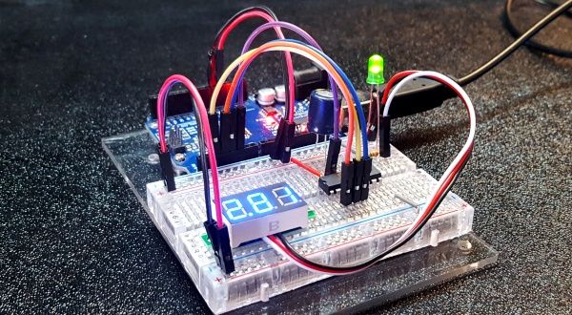
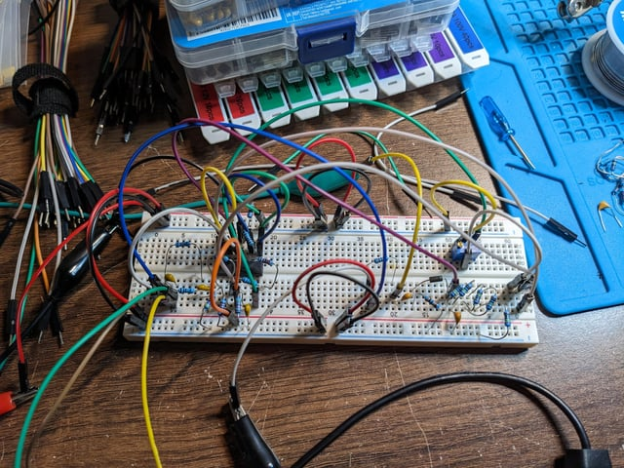
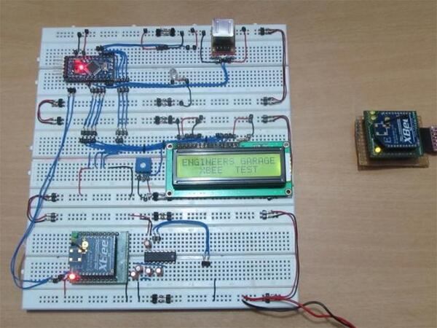
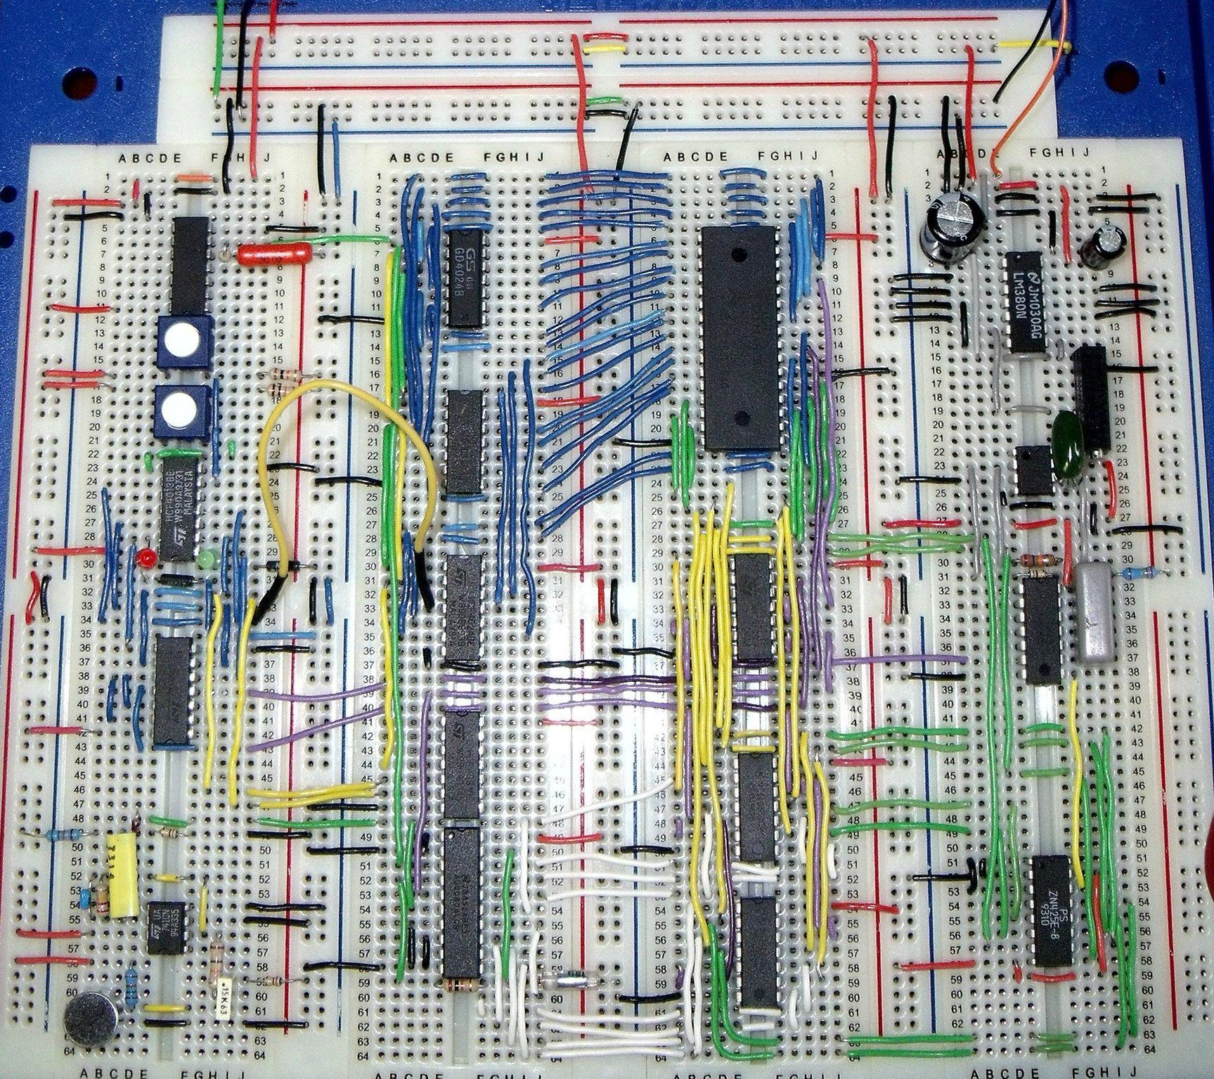
Breadboards
Lots of ways to wire a breadboard.
There is no “right” way as long as it works.

Slide 4
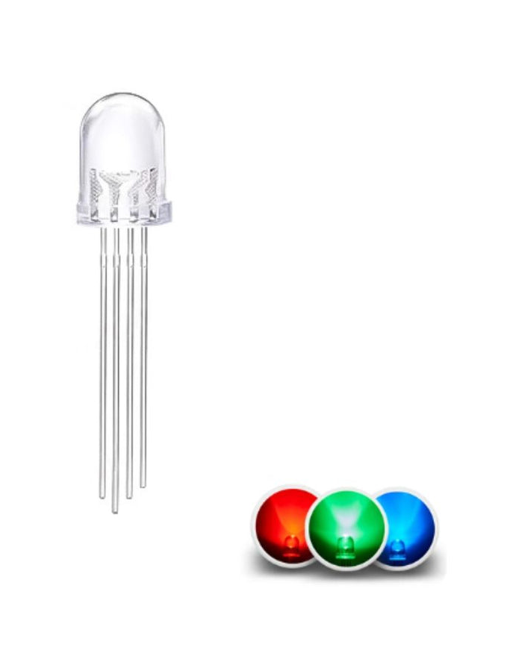
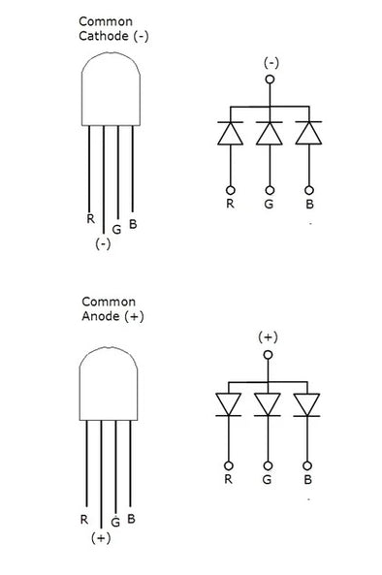
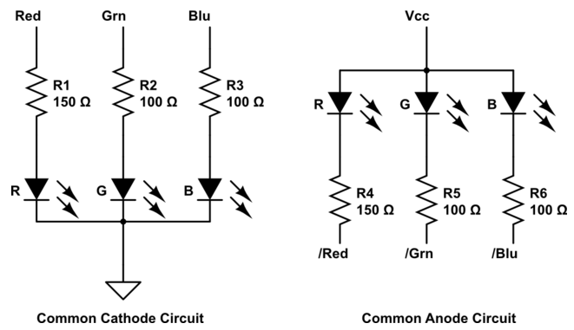
RGB LED
Multi-color LEDs often come packaged with 3 independent pins and 1 common pin.
Common Anode connects the positive sides together
Common Cathode connects the negative sides together

Slide 5
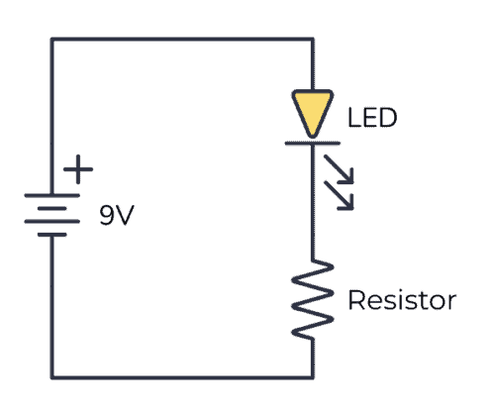
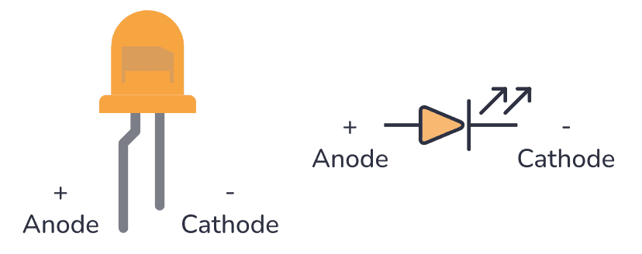
RGB LED Wiring
There are many ways to connect these diodes. The chosen method will depend on the goal and the low level electrical requirements of the LED.
Current Flow
+
The Forward Voltage is the. Amount of “voltage drop” across the diode
-
+
The resistor also has a “voltage drop”. In this circuit it acts as a current limiter.
-

Slide 6
RGB LED Wiring
The LED’s electrical parameters need to be taken into account when wiring the circuit.
In addition, the Microcontroller will also have electrical limits for what it can source or sink.

Slide 7
BME280
Environmental Sensor

Slide 8
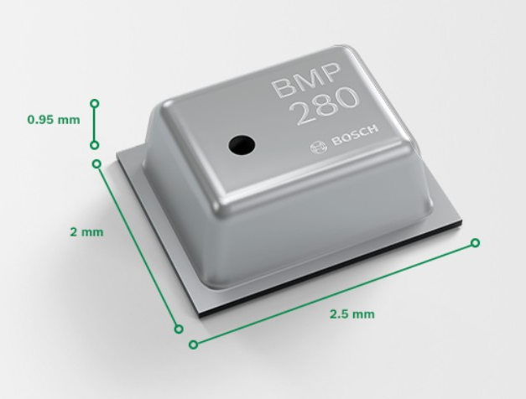
Bosch Sensortec BMP280
The BMP280 is an absolute barometric pressure sensor, which is especially feasible for mobile applications. Its small dimensions and its low power consumption allow for the implementation in battery-powered devices such as mobile phones, GPS modules or watches. The BMP280 is based on Bosch’s proven piezo-resistive pressure sensor technology featuring high accuracy and linearity as well as long-term stability and high EMC robustness. Numerous device operation options guarantee for highest flexibility. The device is optimized in terms of power consumption, resolution and filter performance.
Parameter | Technical data
Operation range | Pressure: 300...1100 hPa Temperature: -40…85°C
Absolute accuracy (950...1050 hPa, 0…+40°C) | ~ ±1 hPa
Relative accuracy p = 700…900hPa (Temp. @ 25°C) | ± 0.12 hPa (typical) equivalent to ±1 m
Average typical current consumption (1 Hz data rate) | 3.4 μA @ 1 Hz
Average current consumption (1 Hz data refresh rate) | 2.74 μA, typical (ultra-low power mode)
Average current consumption in sleep mode | 0.1 μA
Average measurement time | 5.5 msec (ultra-low power preset)
Supply voltage VDDIO | 1.2 ... 3.6 V
Supply voltage VDD | 1.71 ... 3.6 V
Resolution of data | Pressure: 0.01 hPa ( < 10 cm) Temperature: 0.01° C
Temperature coefficient offset (+25°…+40°C @900hPa) | 1.5 Pa/K, equiv. to 12.6 cm/K
Interface | I²C and SPI
Package dimensions | 8-Pin LGA with metal
Link to product page
Link to Datasheet

Slide 9
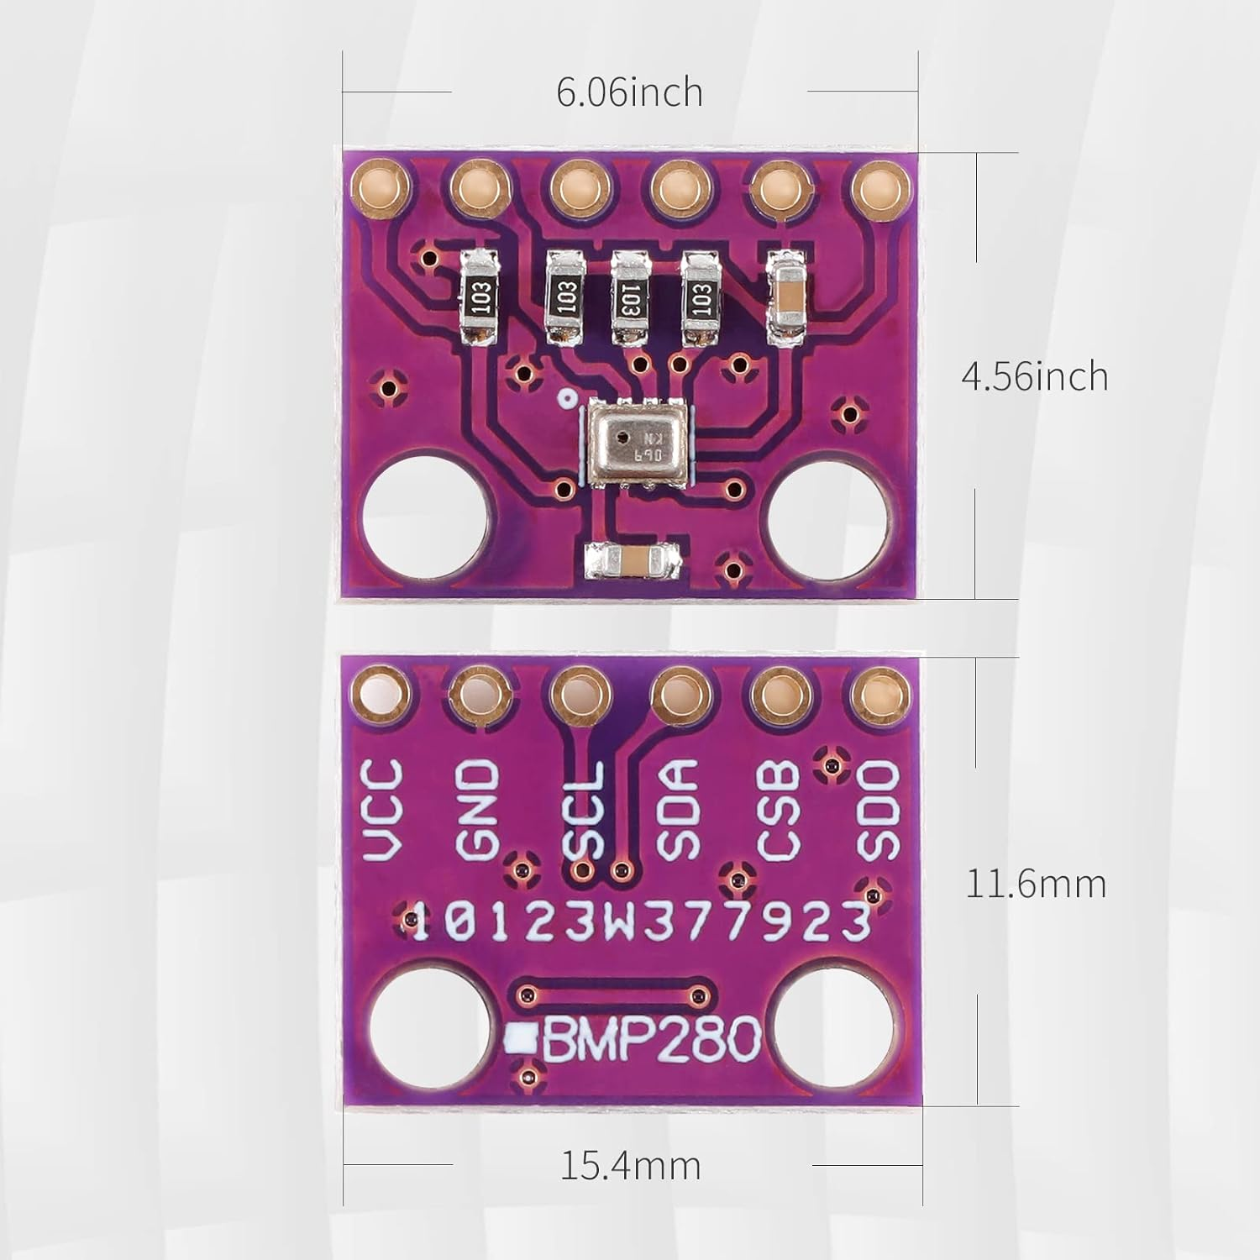
Bosch Sensortec BMP280
The sensor module is pictured here.
VCC is connected to 3.3V
GND is connected to Ground
SCL is the SPI Clock
SDA is the SPI MOSI Signal
SDO is the SPI MISO Signal
CSB is the SPI Chip Select
Top
Bottom
Link to product page
Link to Datasheet

Slide 10
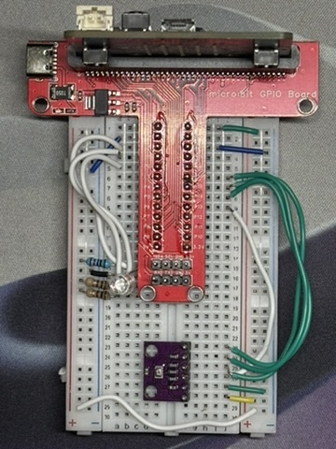
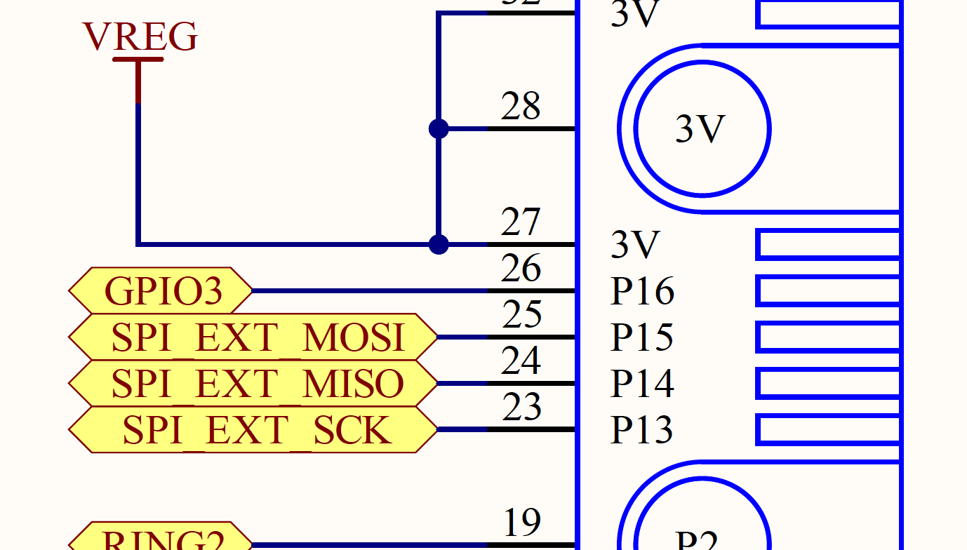
Board Wiring
Top
P0: Red
3.3V (+)
P1: Green
GND (-)
P16: CS (CSB)
P2: Blue
P15: MOSI (SDA)
Bottom
P14: MISO (SDO)
P13: SCK (SCL)
P0: Red (+)
GND (-)
P1: Green (+)
P2: Blue (+)
SDO (MISO)
CSB (CS)
SDA (MOSI)
SCL (SCK)
GND (-)
Link to product page
VCC (+)
3.3V Jumper
From Right to Left
Link to Datasheet

